Slide 1
Project Report On Telecommunication Customer Churn
By Dhanush

Slide 2
Problem Statement
All over the world, Numerous telecom companies are present. To keep up in the competition and expand their business client have to invest in the market. But, due to increasing competition, company is facing severe loss of revenue and loss of potential customers. So, the client wants to find out the reasons of losing customers by measuring customer loyalty to regain the lost customers.

Slide 3
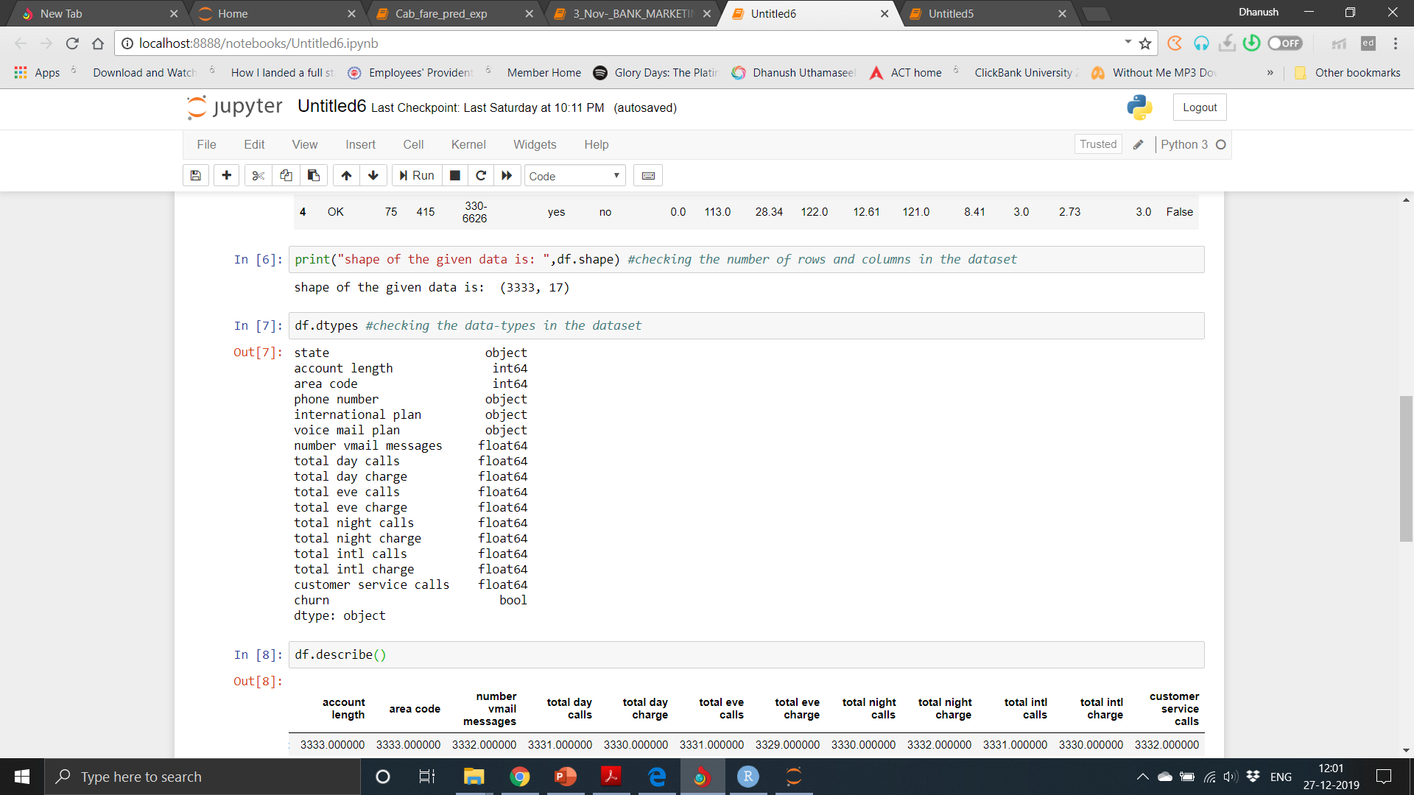
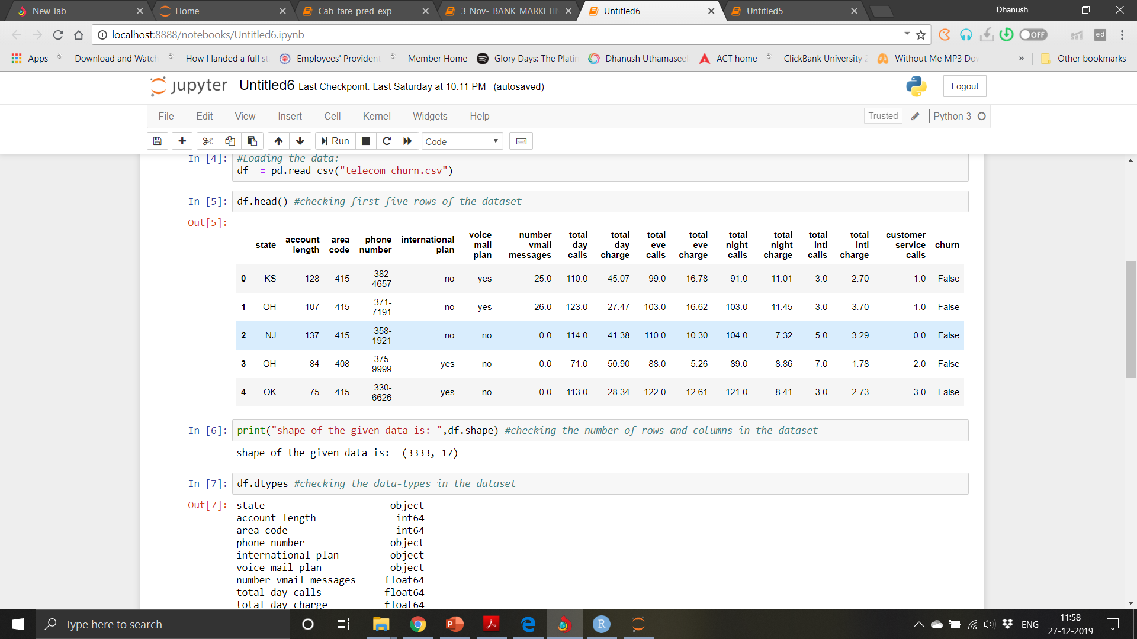
Data
Understanding of data is the very first and important step in the process of finding solution of any business problem. Here in our case our company has provided a data set with following features, we need to go through each and every variable of it to understand and for better functioning. Size of Dataset Provided: - 3333 rows, 17 Columns (including dependent variable) Missing Values: Yes Outliers Presented: Yes

Slide 4
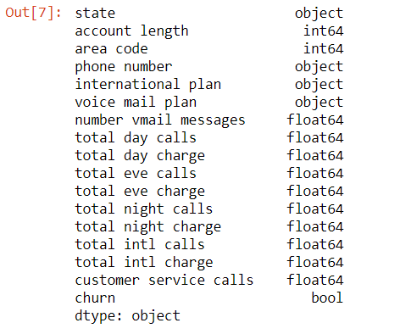

Slide 5
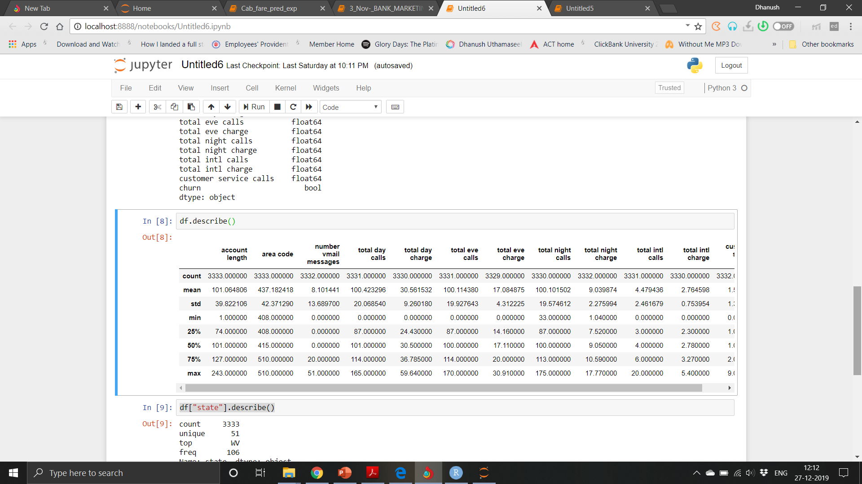
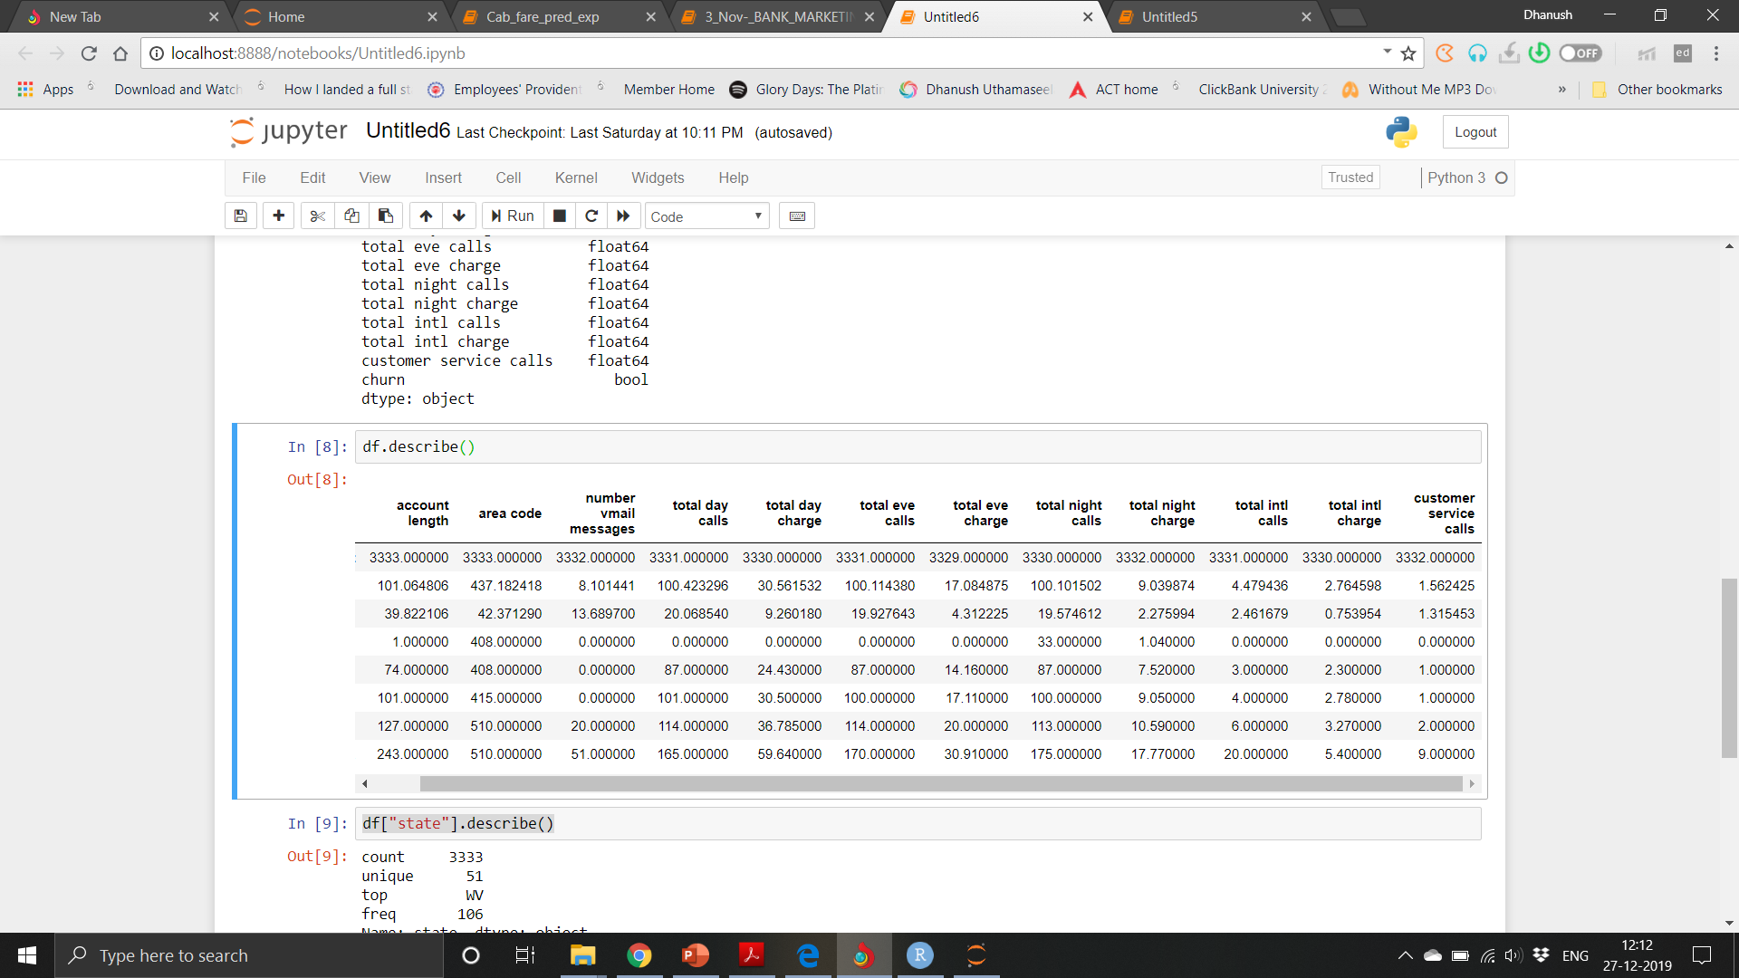
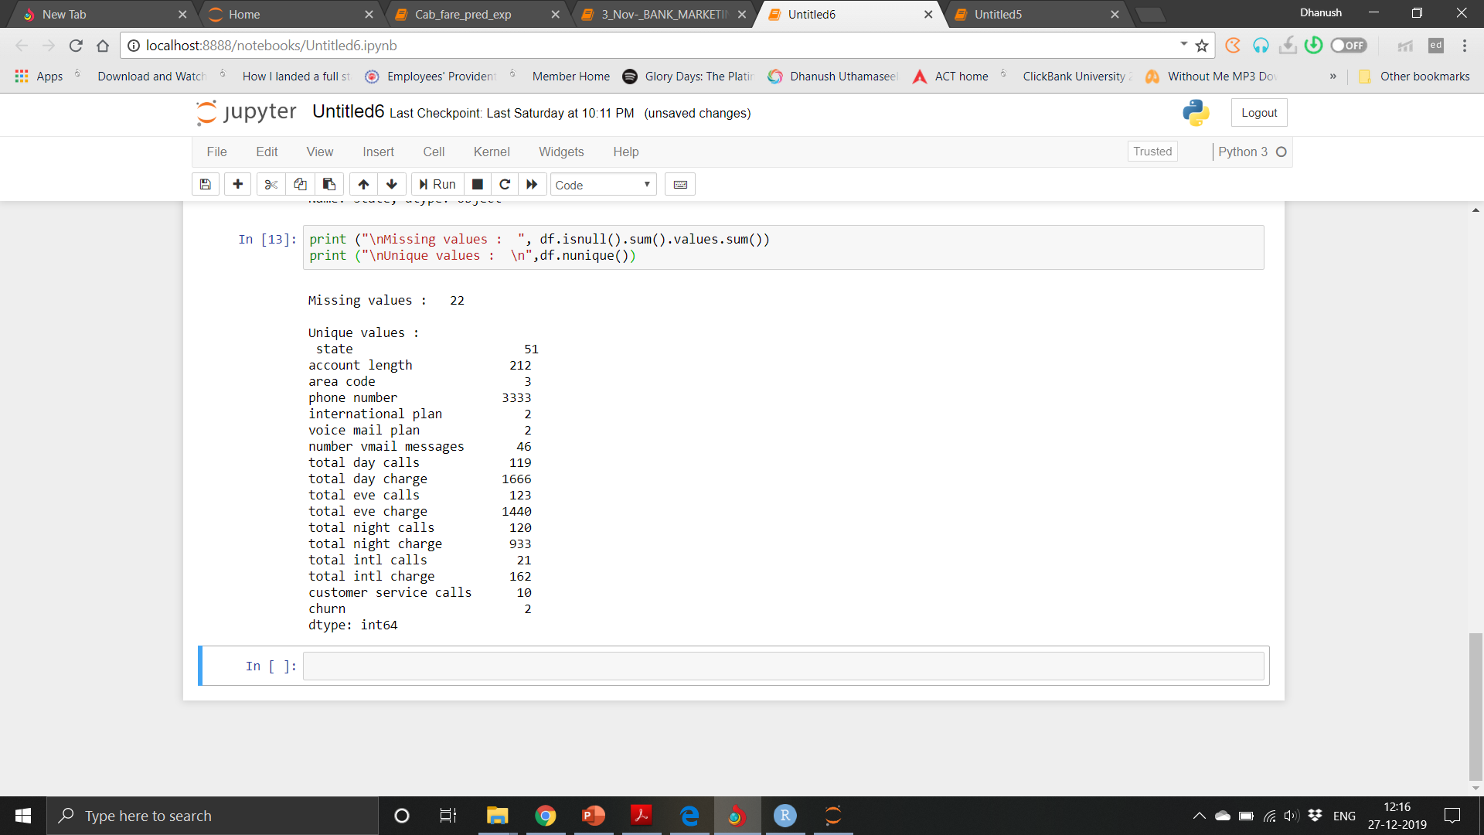

Slide 6
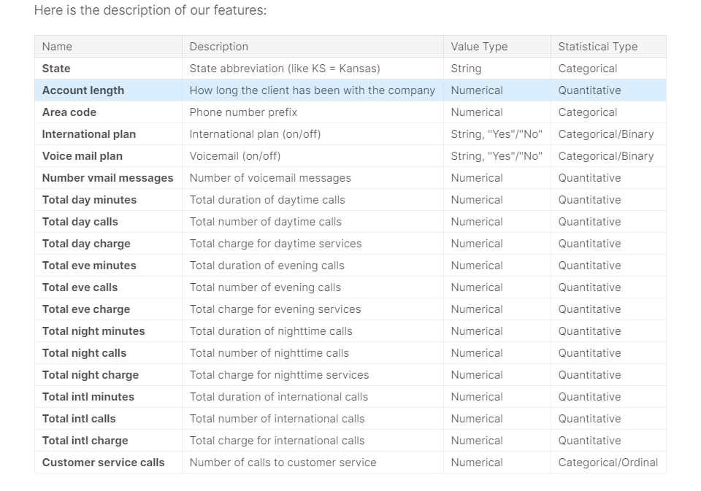

Slide 7
Methodology
Pre-Processing
When we required to build a predictive model, we require to look and manipulate the data before we start modelling which includes multiple preprocessing steps such as exploring the data, cleaning the data as well as visualizing the data through graph and plots, all these steps is combined under one shed which is Exploratory Data Analysis, which includes following steps:
• Data exploration and Cleaning
• Missing values treatment
• Outlier Analysis
• Feature Selection
• Features Scaling
o Skewness and Log transformation Visualization
• Visualization

Slide 8
Modelling
Once all the Pre-Processing steps has been done on our data set, we will now further move to our next step which is modelling. Modelling plays an important role to find out the good inferences from the data. Choice of models depends upon the problem statement and data set. As per our problem statement and dataset, we will try some models on our preprocessed data and post comparing the output results we will select the best suitable model for our problem. As per our data set following models need to be tested:
• Linear regression
• Decision Tree
• Random forest,
• Gradient Boosting
Model Selection
The final step of our methodology will be the selection of the model based on the different output and results shown by different models. We have multiple parameters which we will study further in our report to test whether the model is suitable for our problem statement or not.

Slide 9
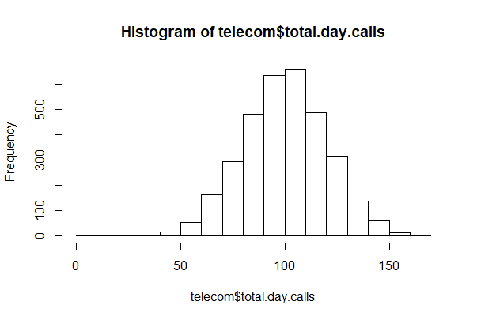
Pre-Processing
Data exploration and Cleaning (Missing Values and Outliers)
The very first step which comes with any data science project is data exploration and cleaning which includes following points as per this project:
Histogram of continuous variables

Slide 10
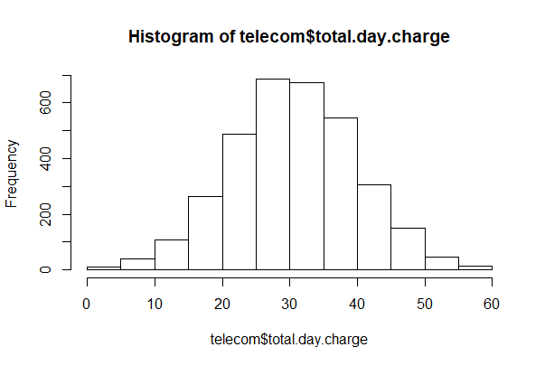
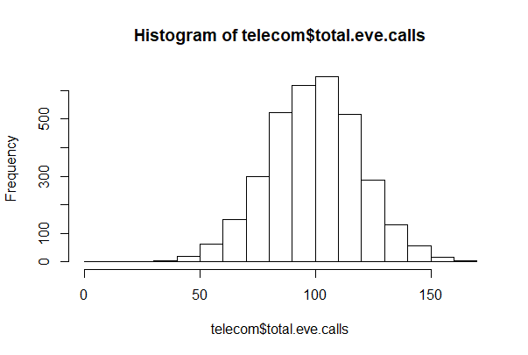

Slide 11
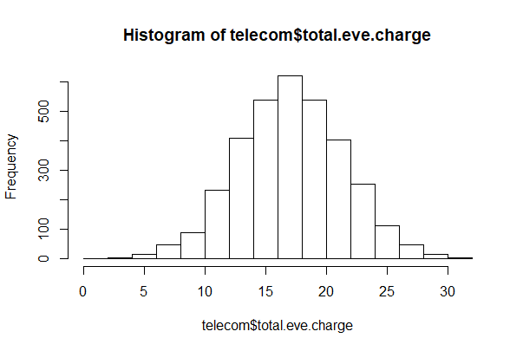
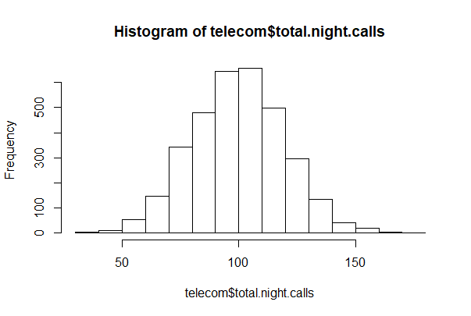

Slide 12
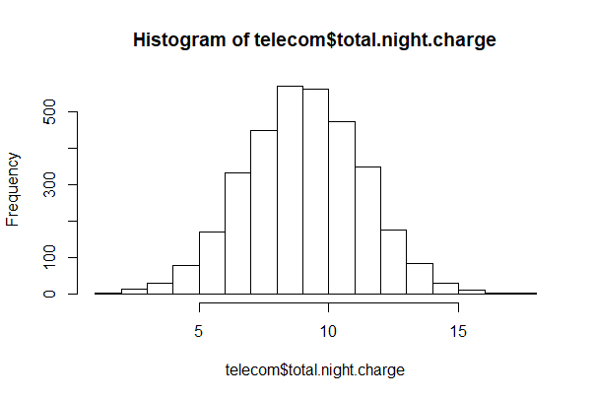
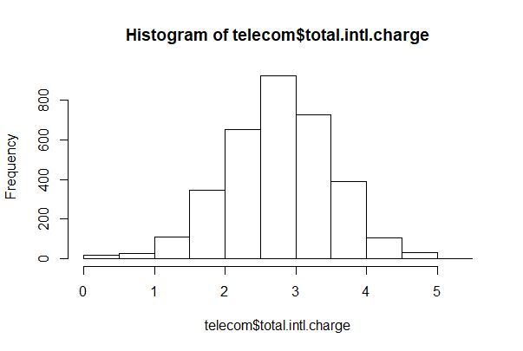

Slide 13
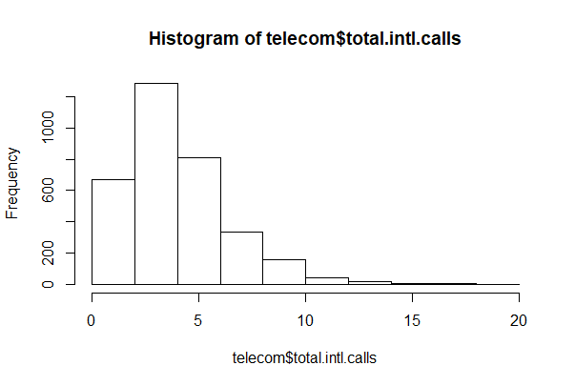
Skewed Distribution
Skewness is asymmetry in a statistical distribution, in which the curve appears distorted or skewed either to the left or to the right. Skewness can be quantified to define the extent to which a distribution differs from a normal distribution. Here we tried to show the skewness of our variables

Slide 14
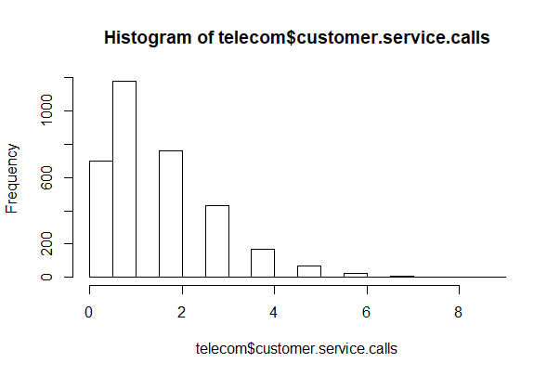
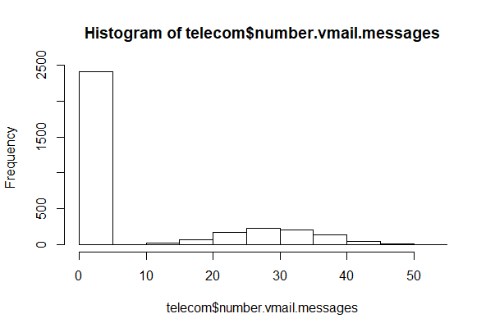

Slide 15
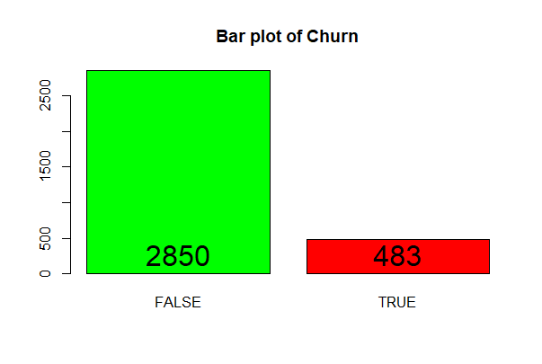

Slide 16
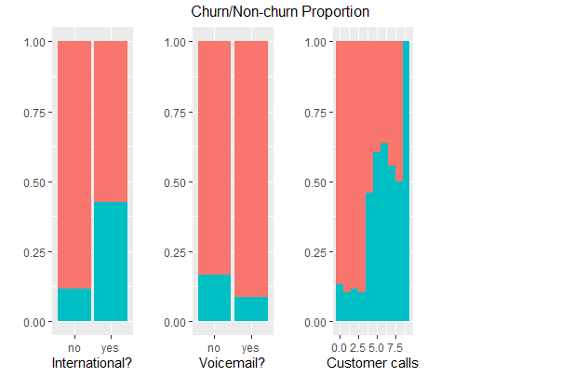

Slide 17
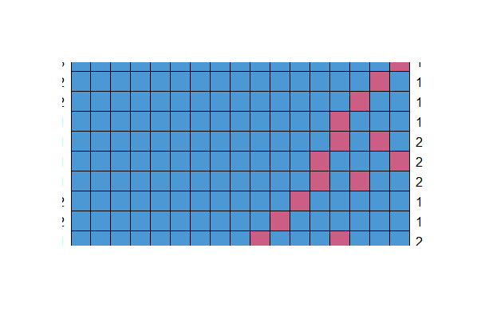
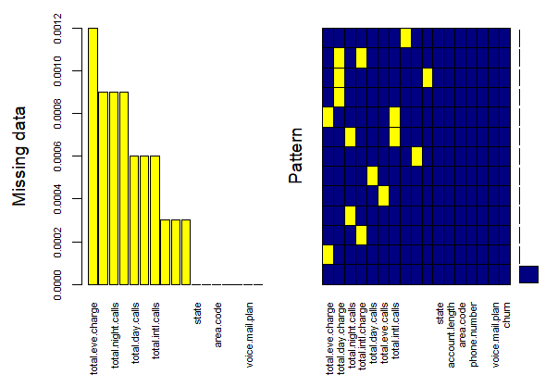

Slide 18
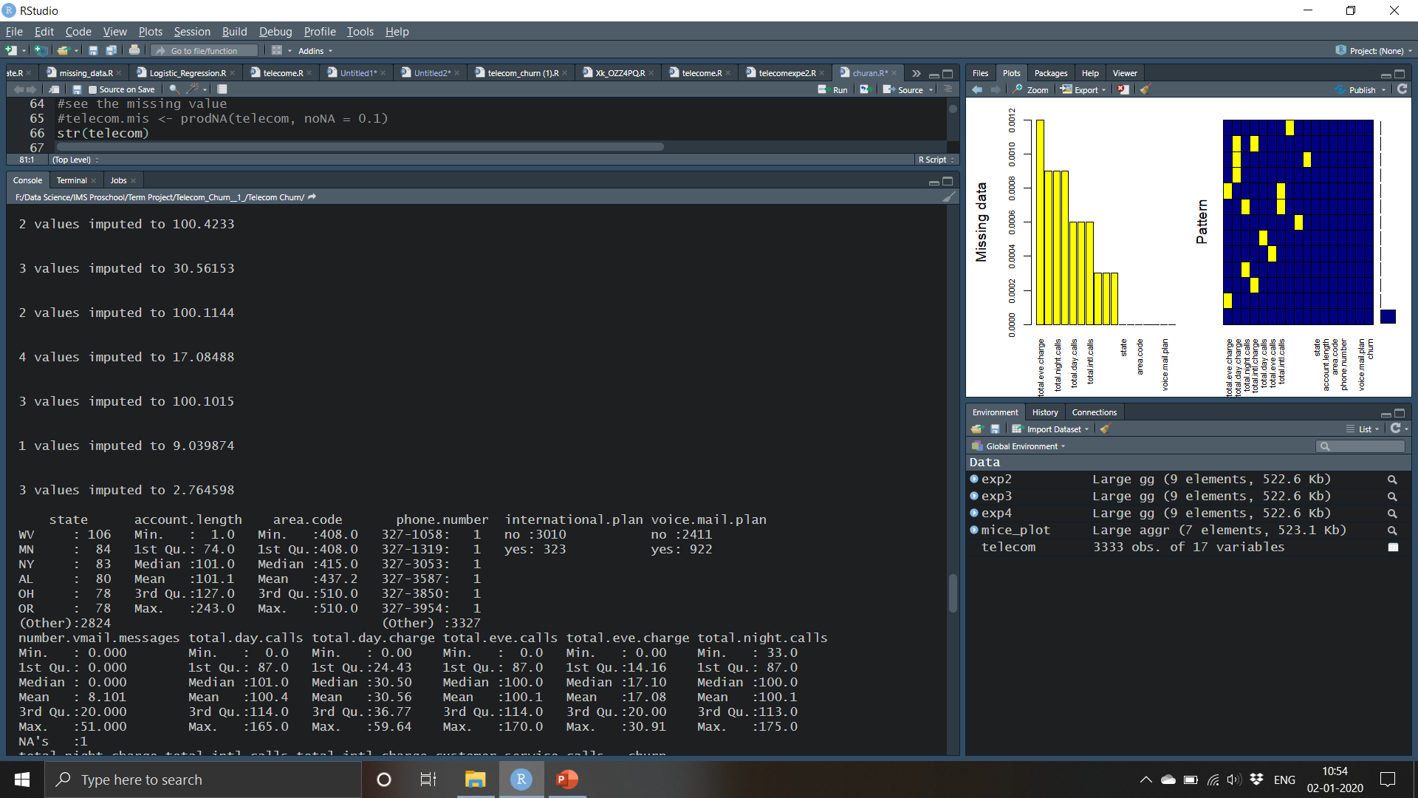
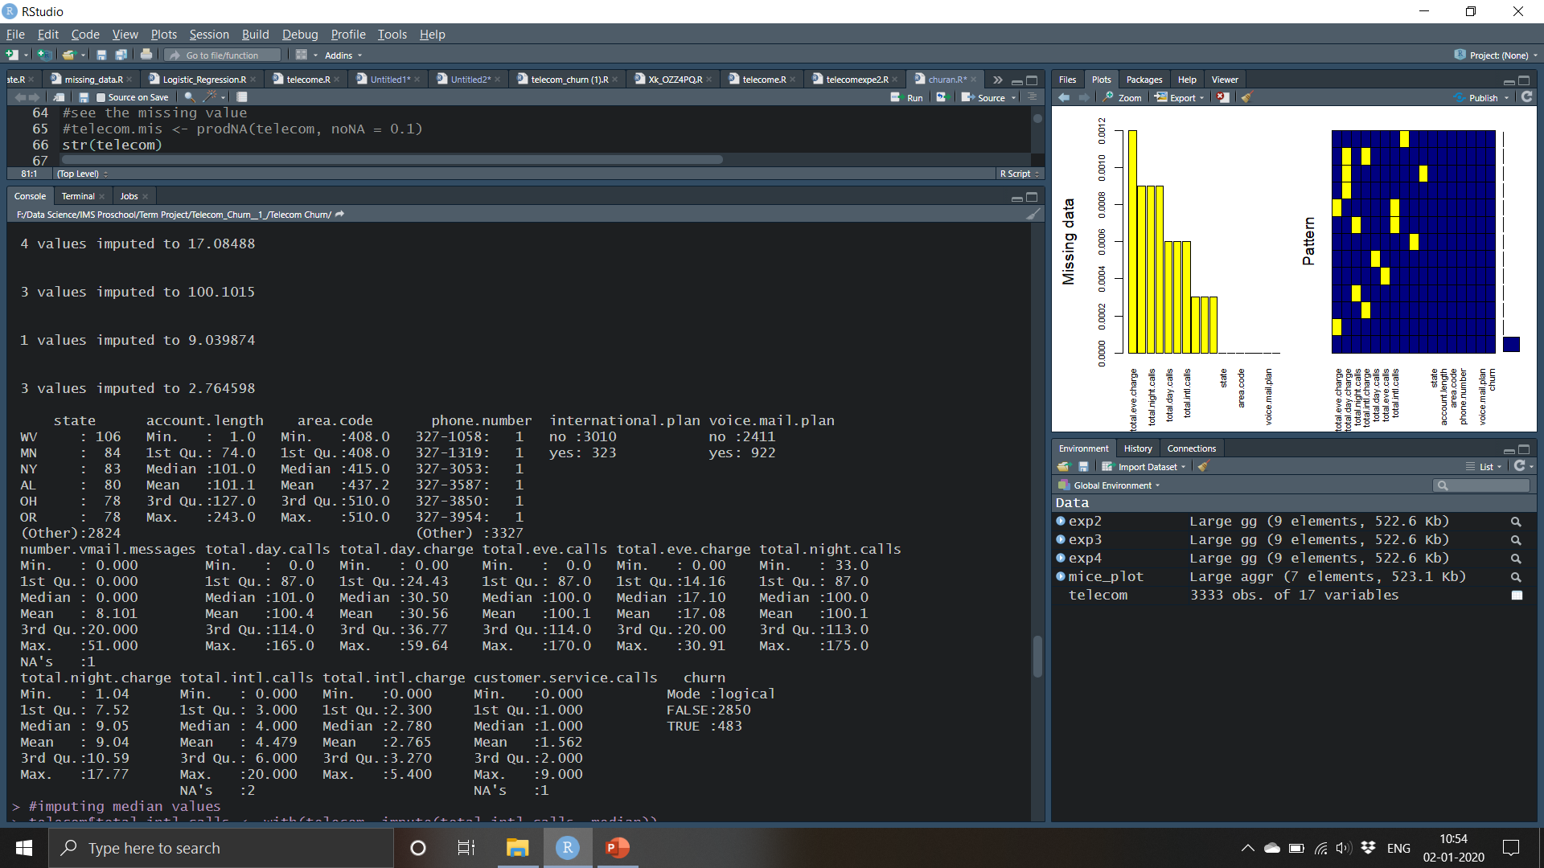
Depending on the outliers we imputed the missing values with Mean and Median
Below is the mean imputation for the below variables

Slide 19


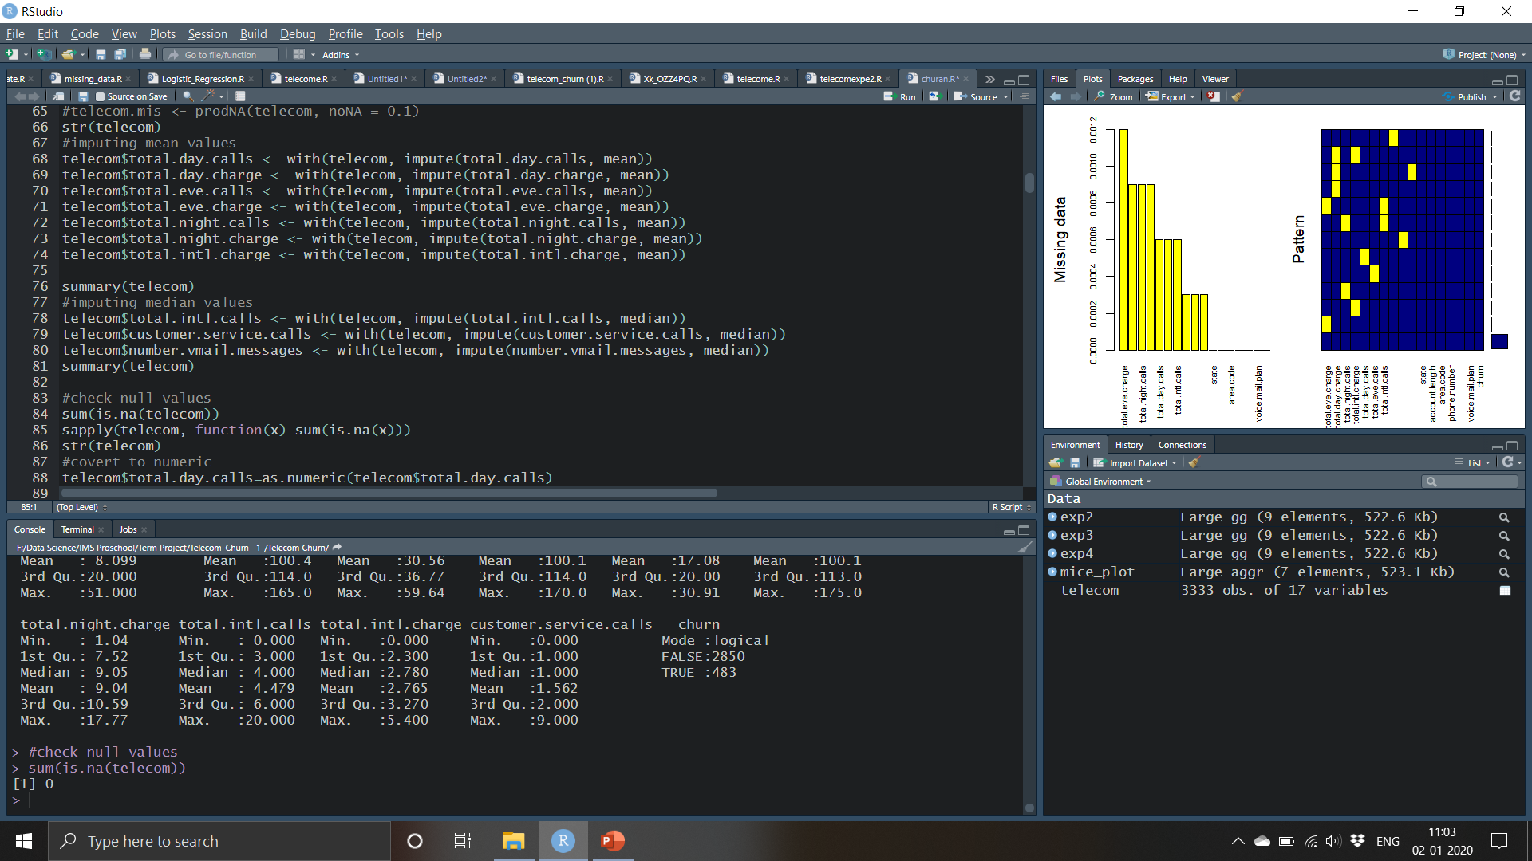
Below is the Median Imputation

Slide 20
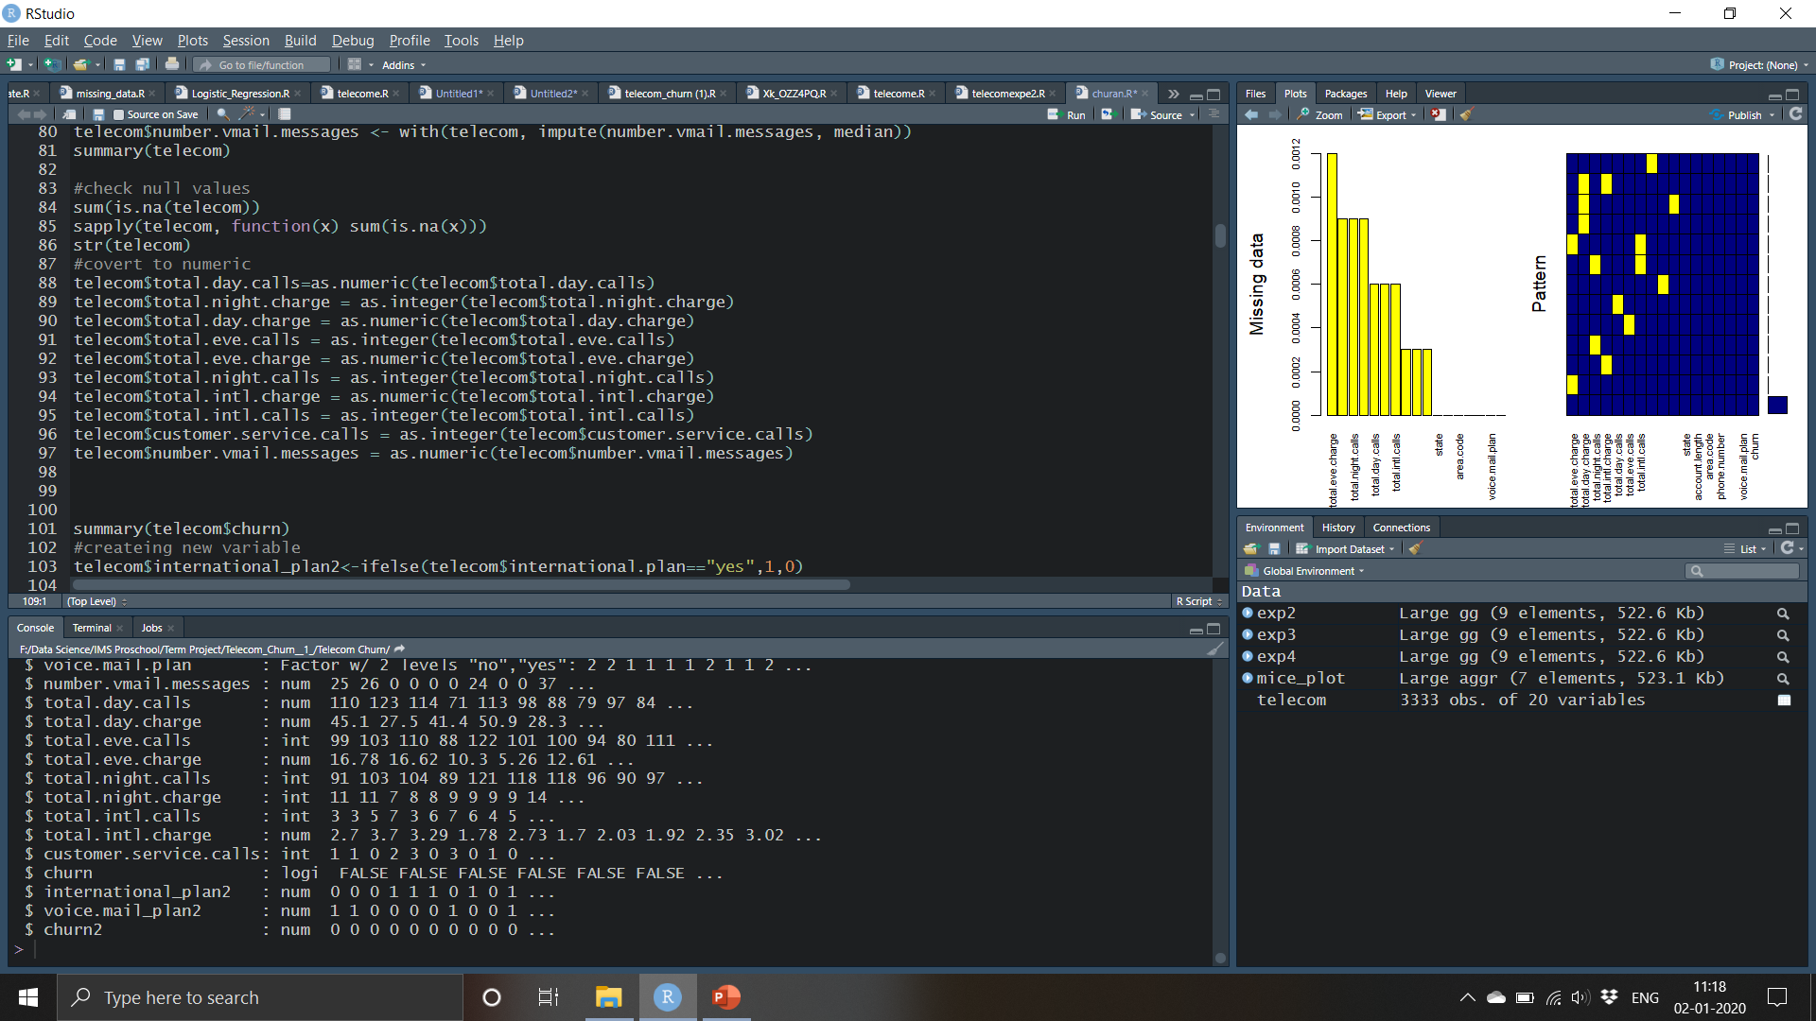
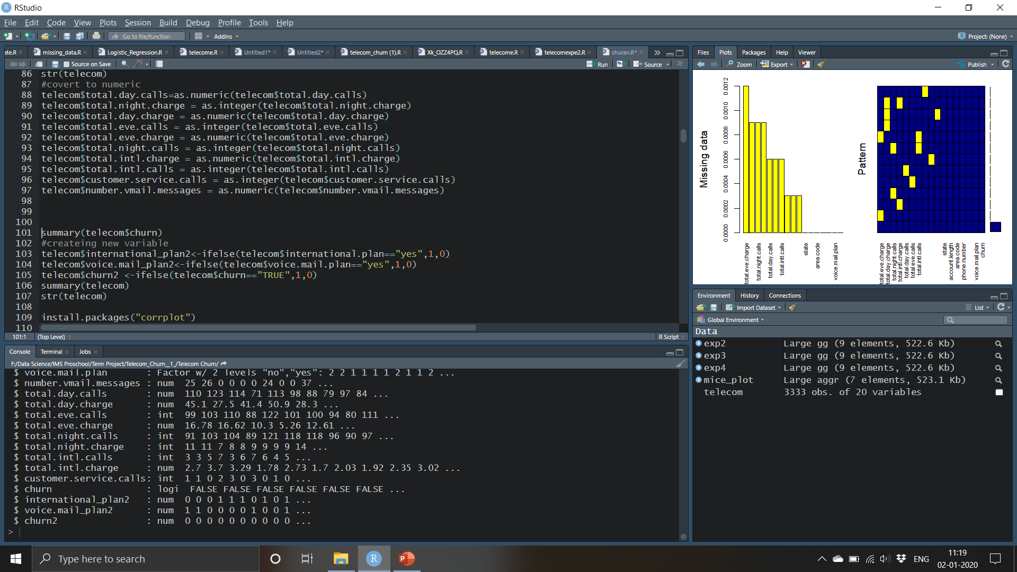
In the previous slide we see that there are no missing values and it is been replaced with mean and median next step would be finding the outliers and if there are any outliers we will see if we can remove outliers or we will see if we can do anything else
Firstly we will convert all the variables to numeric the then we create new variables to replace Yes or No and True or False to 1s and 0s ,below codes will take care of the same

Slide 21
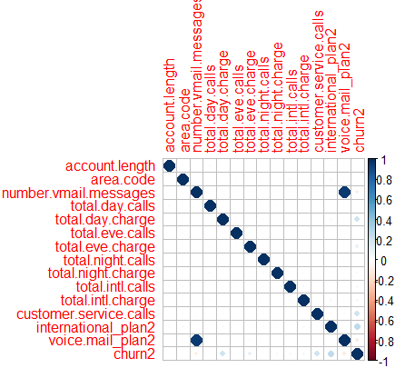
Correlation
Correlation is a statistical technique that can show whether and how strongly pairs of variables are related
Below is the correlation plot of our dataset

Slide 22
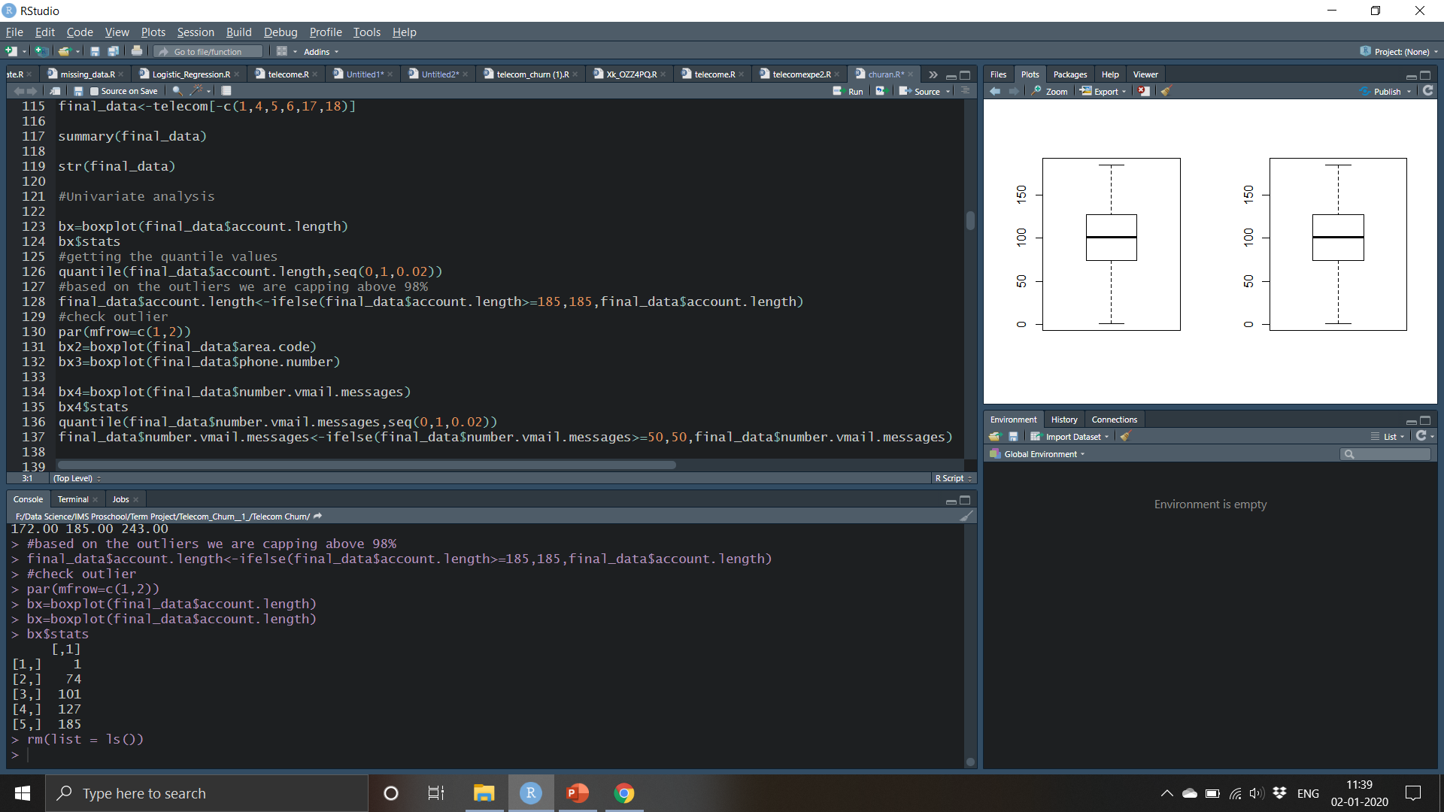

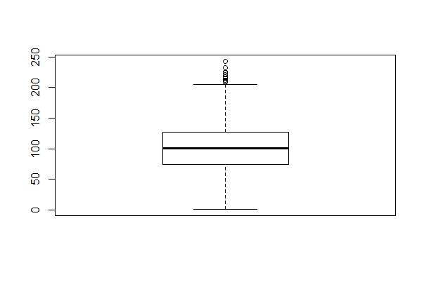
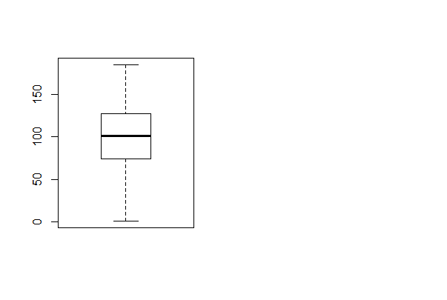
Now we do univariate analysis and remove the outliers , We would use the below code for the same.
Before removing outlier
We check for the outliers in other variables as well and remove the outliers using the same method

Slide 23
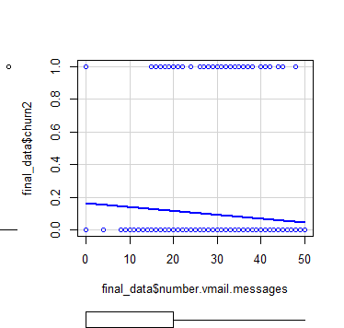
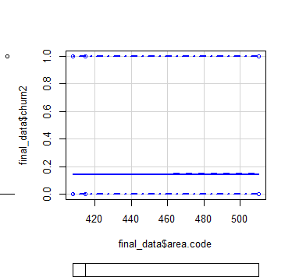
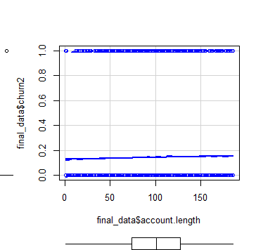
Scatterplots for Bivariate Analysis

Slide 24
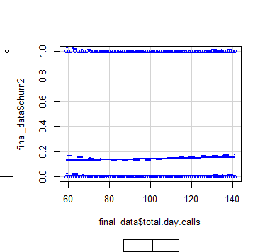
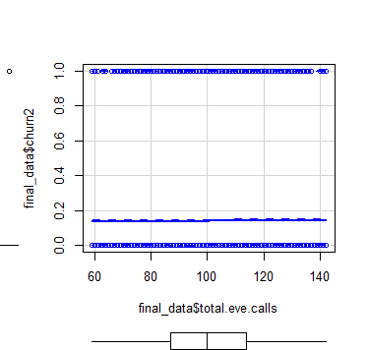
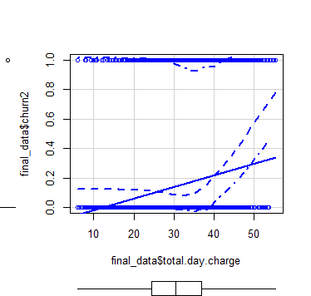

Slide 25
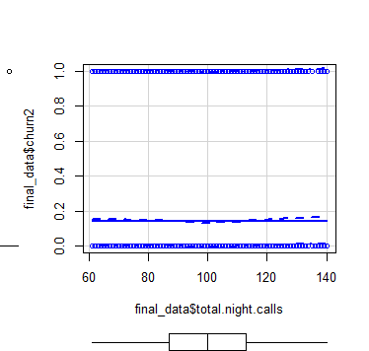
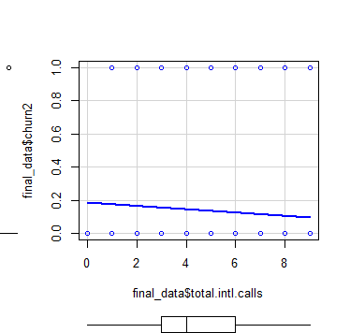
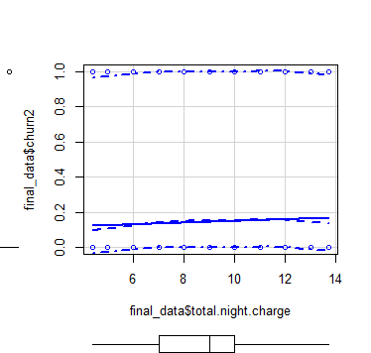

Slide 26
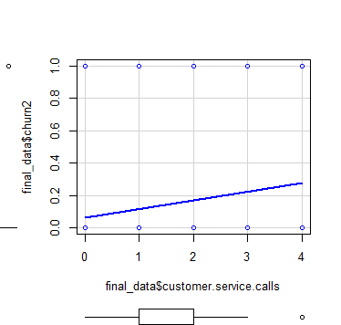
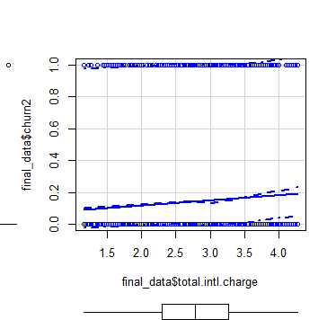

Slide 27
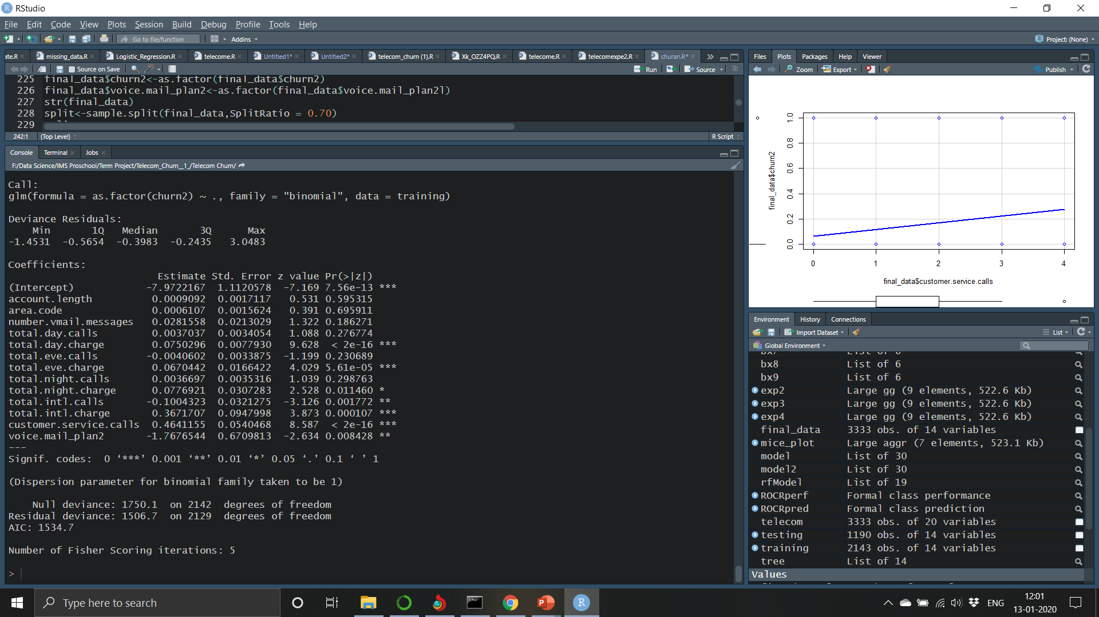
Diving the data into train and test
70% of data is train and the 30% is test
Firstly we apply logistic regression for the variables after we clean the data
Below are the insights

Slide 28
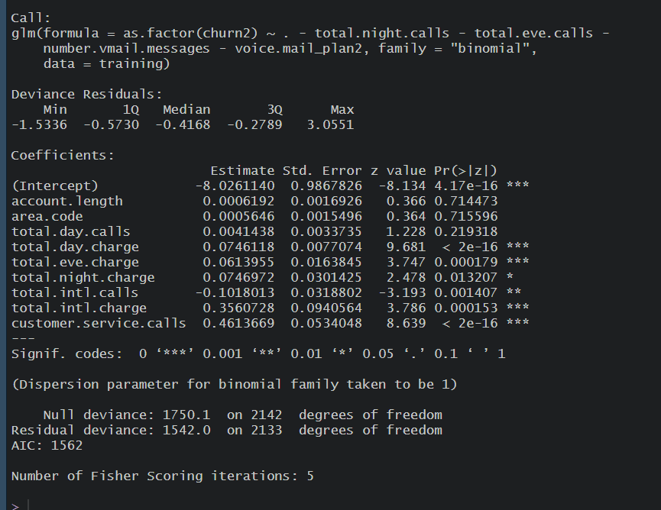
Now we keep the highly significant variables and retrain the model using logistic regression

Slide 29
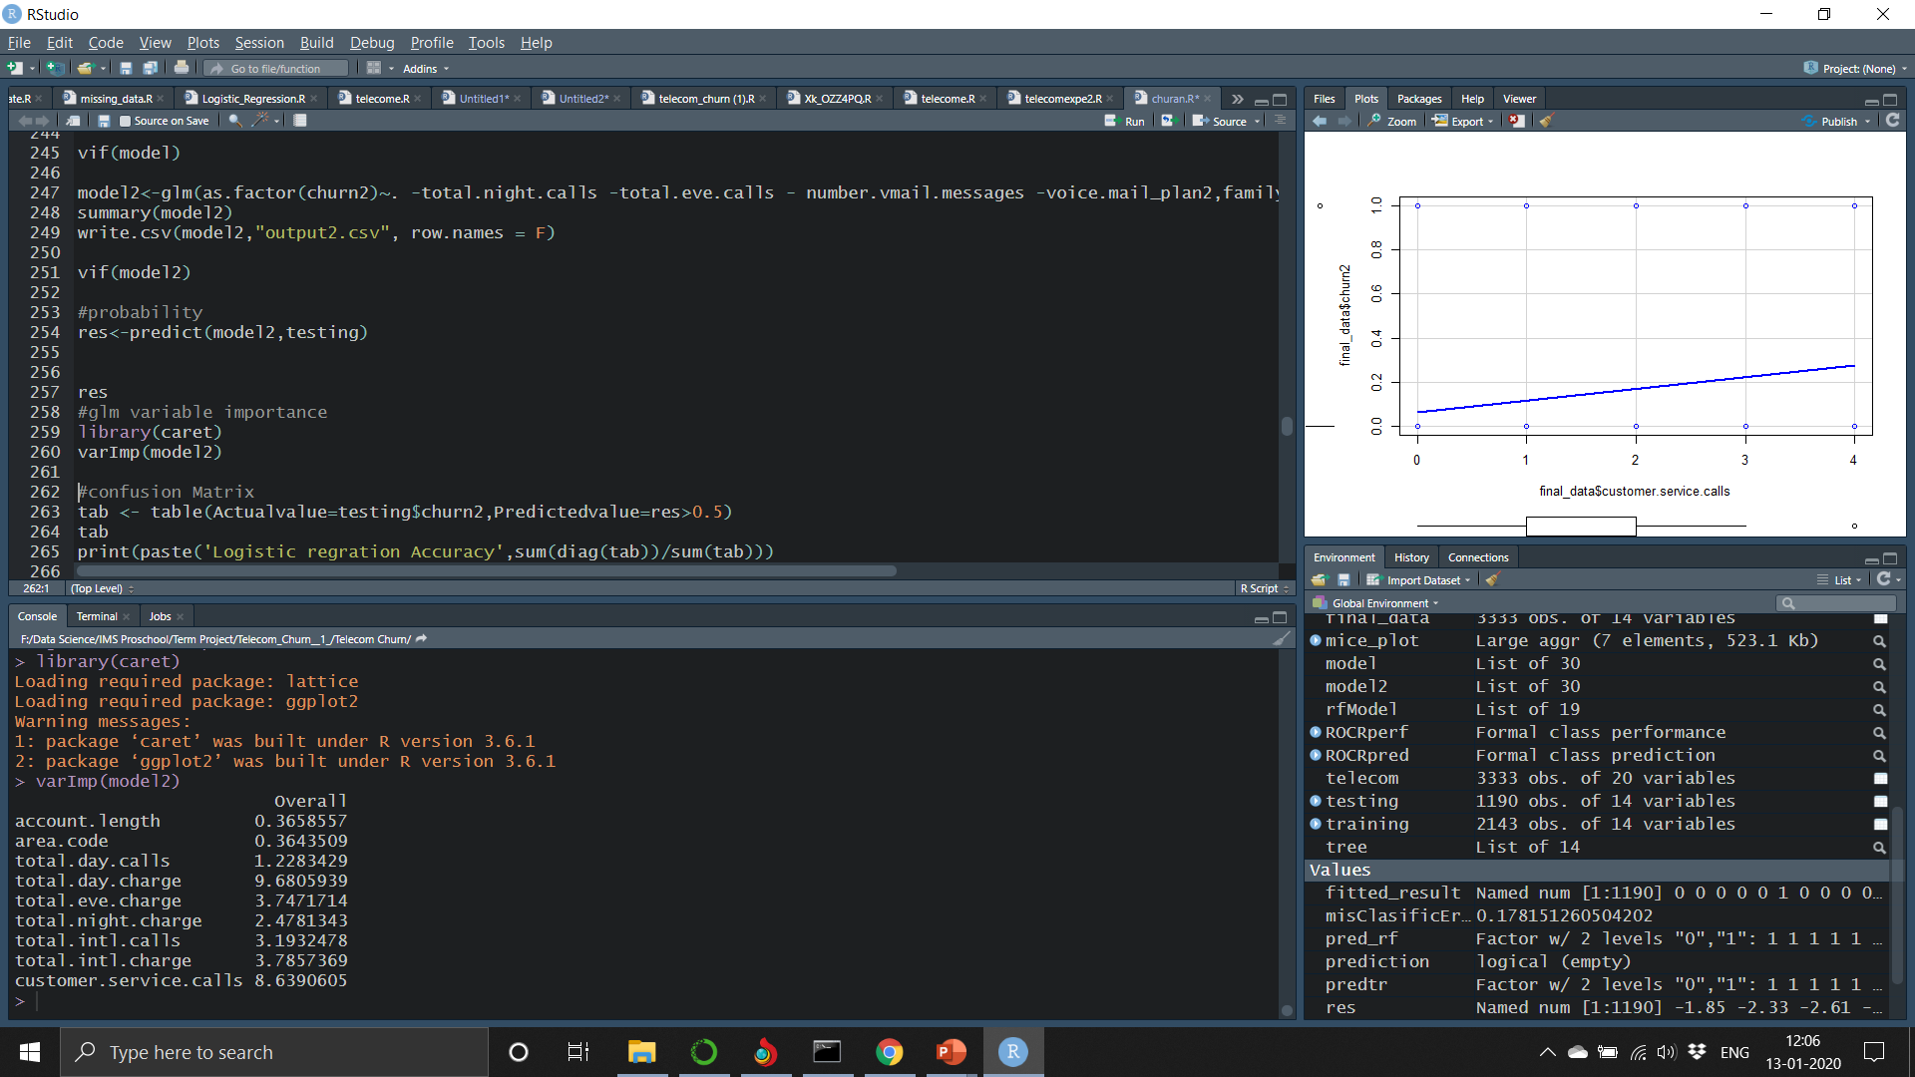
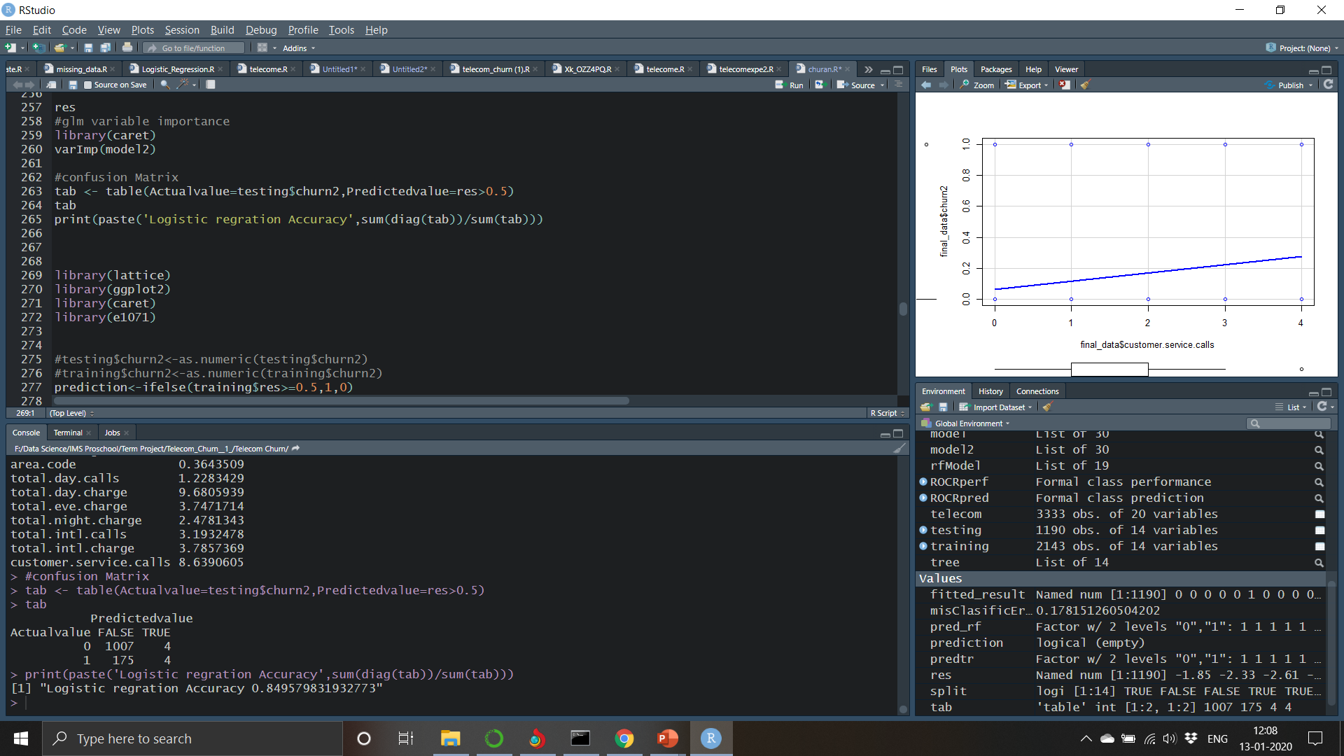
We are find the important variables in the model
Accordingly if we draw a confusion matrix and if we find the accuracy accordingly

Slide 30
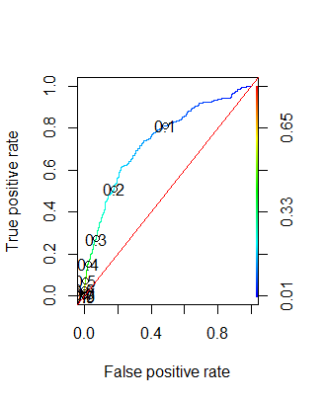
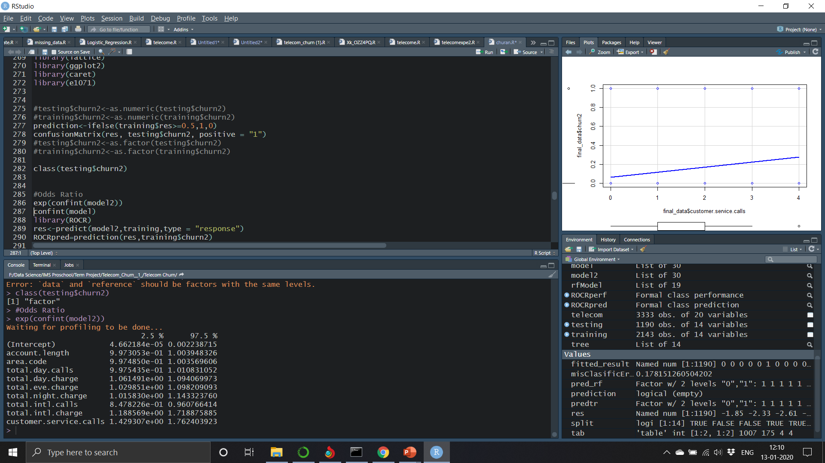
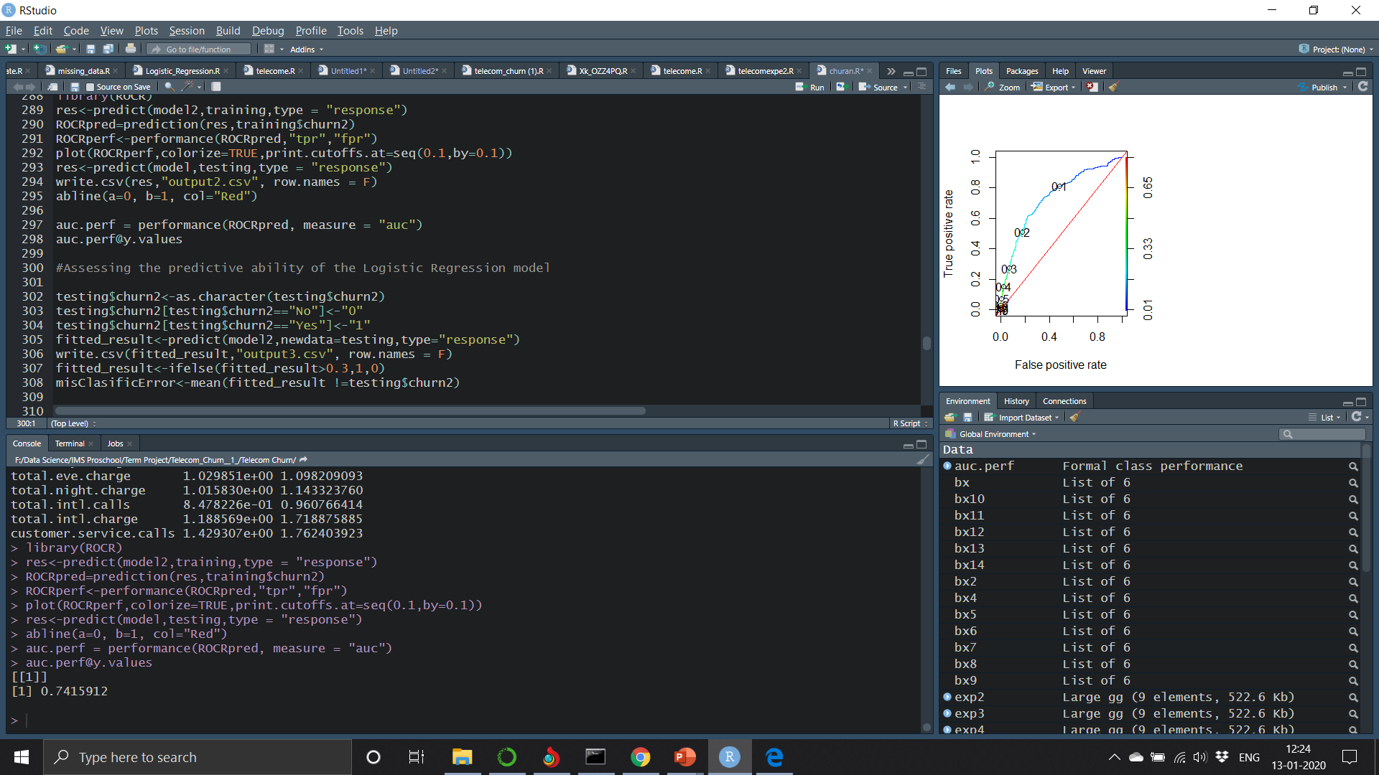
Confidence Interval of the model
We have the ROCR curve which clearly tells us the cut off and yes we can calculate Area Under the Curve
Below is the Area Under the Curve of our model

Slide 31
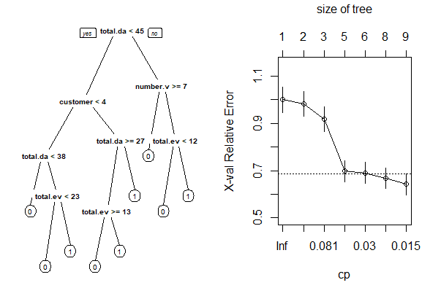
We apply Decision Tree for the model and check for the accuracy

Slide 32
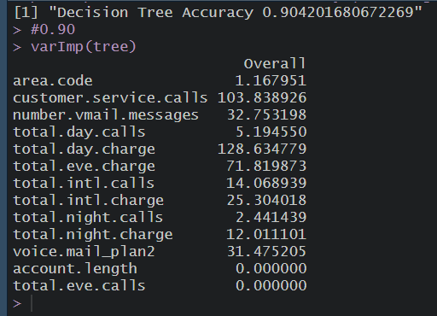
Decision Tree Accuracy and the Important Variables

Slide 33


Finally we apply Random Forest on our model to ,check the accuracy and the important variables

Slide 34
Conclusion
From the previous slides ,the graphs and the model validations ROC, AUC , Accuracy , we have selected Random Forest Algorithm as our modelling technique to build the model
Using the Random Forest Algorithm it is clear that Total day charge has a mean decreased gini value of 141.37 which is the top of all mean decreased gini value and second top would be the 62.02 which is customer service calls
The confusion matrix of the training data gives a accuracy of 100% and testing data using a Random Forest algorithm gives 91.93%
The model shows almost similar accuracy
Hence we can conclude that Total Day Charge and Customer Service Calls are the main reason for the Churn

